Slide 1


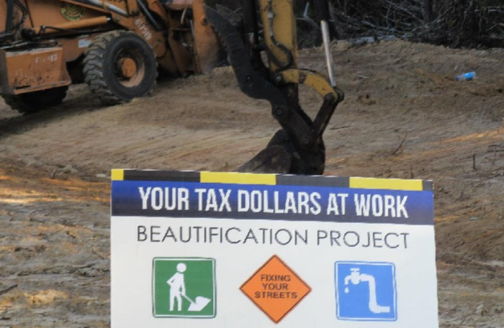
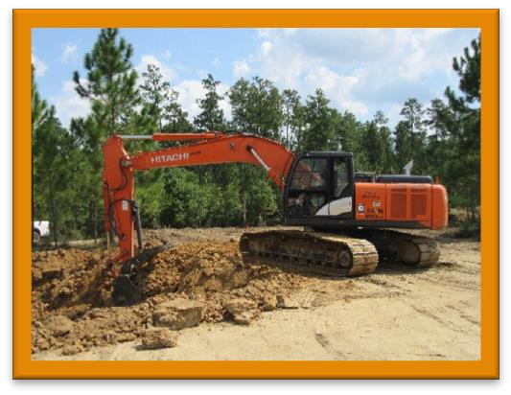
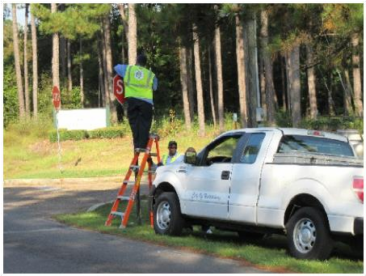
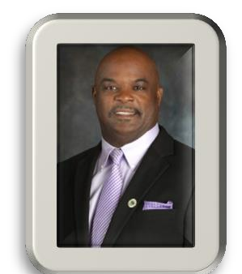


PUBLIC WORKS DIGEST: AN INSIGHT INTO THE DAILY WORKS
Issue 1
 | Public Works Digest: An Insight into the Daily Programs & Projects September 23, 2016
PUTTING YOUR TAX DOLLARS TO WORK FOR A BETTER HATTIESBURG | IN THIS ISSUE
Public Works Digest
The services provided by the Public
Works Department are essential for maintaining a secure and modern lifestyle. The Public Works Department is one of the City of Hattiesburg’s largest departments and includes:
the highest quality of services today and in the future.
The mission of the Public Works Department is to deliver excellent public works services that maintain and improve the City of Hattiesburg’s infrastructure through strong community partnerships, straightforward policies, and responsible stewardship of fiscal and human
resources. The ultimate goal of our department is to become a recognized leader in the delivery of public services by providing efficient and quality services, as well as, improving the quality of life for the citizens of Hattiesburg
Drainage & Health Sanitation & Traffic Streets & Street Cleaning Shop & Airport Construction
GO & FS divisions
Tatum Park Construction
Ground is broken for new retention pond at the site of the new Parks & Recreation Maintenance Division site located at Tatum Park... pg. 2
From the Director’s Desk
We are committed to improving the quality of life for all the residents by delivering safe, reliable, efficient and effective services to every neighborhood with a “can-do” attitude.
Our goal is to preserve public improvements by investing in our infrastructure before the onset of major problems. The Hattiesburg Department of Public Works is dedicated to working as a team to ensure our residents receive
Signage Maintenance
The Public Works Department makes a continued effort to update and maintain traffic signs throughout the city...pg. 3

Slide 2
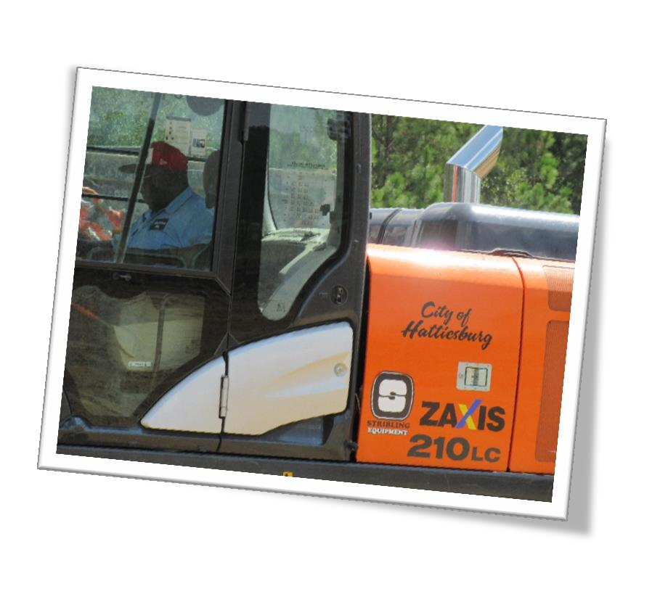
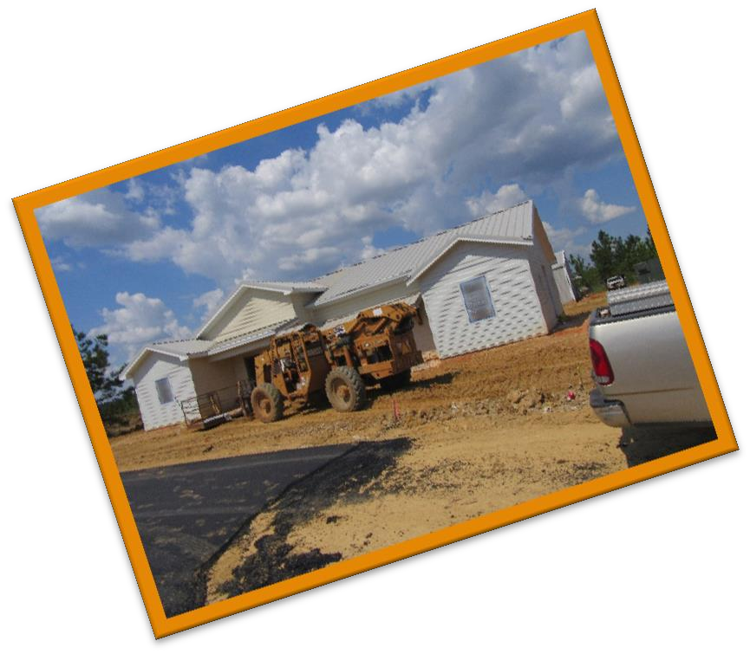
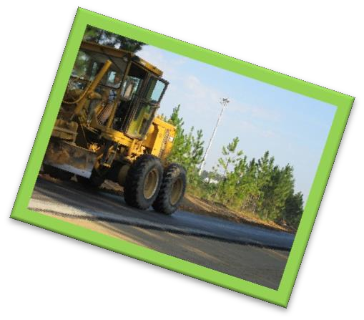
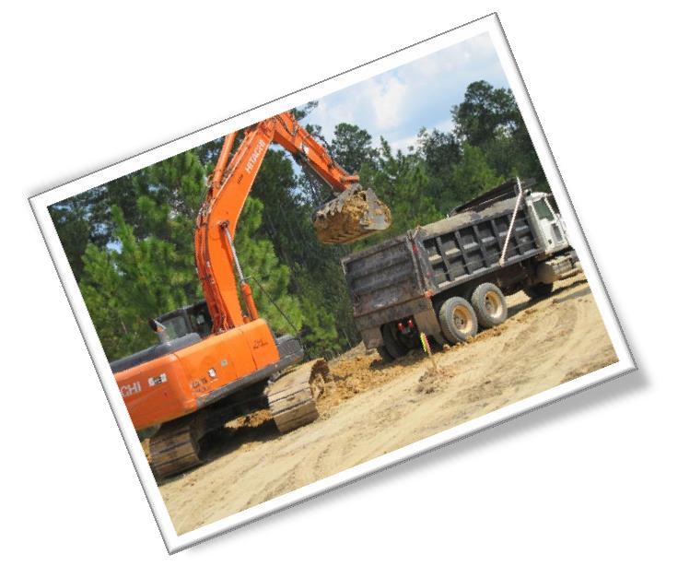
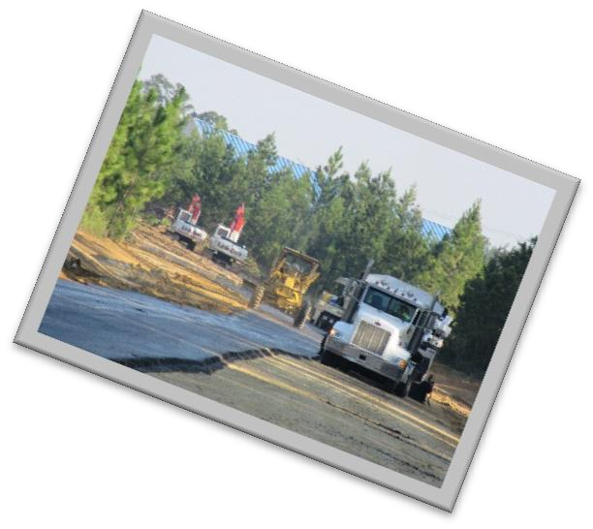
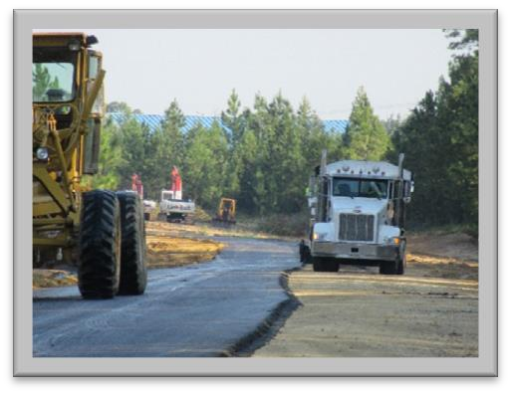

PUBLIC WORKS DIGEST: AN INSIGHT INTO THE DAILY WORKS |
Issue 1
2
Tatum Park New Construction
Hattiesburg Construction Division
Tatum Park has positioned itself as one of the City of Hattiesburg’s premier youth association athletic sports complex. Tatum Park is expanding in a most positive aspect as the city’s Parks & Recreation Maintenance Division makes its new home in the area. With the addition of new facilities there comes new challenges and new opportunities for improvements within the area. The Hattiesburg Public Works department, in partnership with Parks & Rec division and Forrest County has broken ground and is now in the process of establishing the new facilities.
Construction and paving projects have made it possible to gain access to the new
facilities and to continue with the new upgrades.
City of Hattiesburg Public Works
associate uses heavy equipment to move soil and begin process of making a retainer pond near the new Parks & Rec Maintenance facility at Tatum Park.
New Construction is underway for the new office of the Hattiesburg Parks & Rec Maintenance Division.

Slide 3
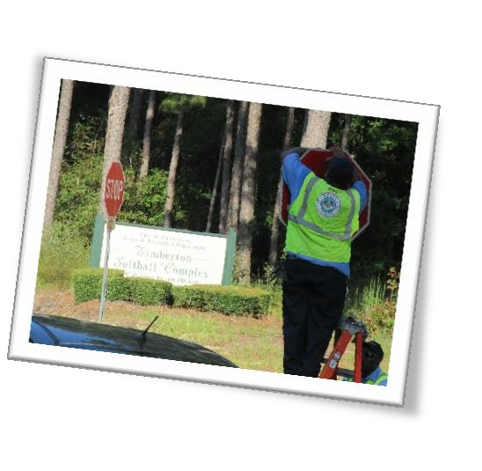
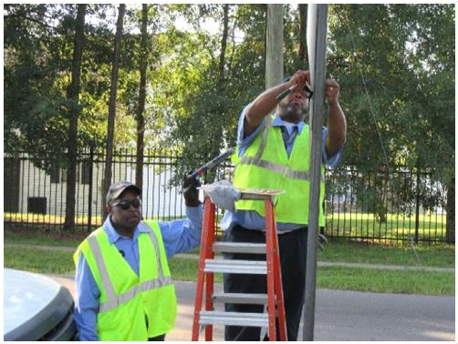
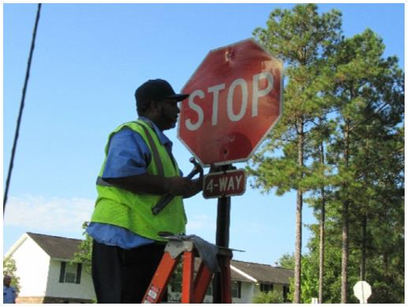
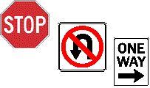
PUBLIC WORKS DIGEST: AN INSIGHT INTO THE DAILY WORKS |
Issue 1
3
Street Sign Maintenance
Hattiesburg Public Works Traffic Division
The Hattiesburg Public Works department reminds all that doing a good job of maintaining regulatory and warning signs makes the road safer for all drivers. You should keep in mind that an accident can occur because of a missing or unreadable sign. Good sign maintenance will improve traffic safety, reduce the chances of a lawsuit against the
community, and increase traffic capacity. Remember "TRAFFIC SIGNS MUST HAVE A
PURPOSE"- they must:
STREET SIGNAGE IMPROVEMENTS
Regulatory signs
Regulatory signs are the most important to the driver because they represent the laws and regulations that are enforceable. They usually require a driver to take a specific action, such as STOP, but can also deny the driver right of entry, such as DO NOT ENTER. Failure to respond to a regulatory sign can result in or contribute to a severe accident. This can occur when a driver
doesn't see a regulatory sign or sees the sign too late and makes an erratic movement. Missing, damaged, or ineffective regulatory signs constitute a potential hazardous condition.
Sign Maintenance
Hattiesburg PW associates William Thomas & Emanuel Thorton replace traffic signs throughout the city.
Fulfill a need.
Command attention and respect.
Convey a clear, understandable message.
Provide enough time for the driver to respond correctly.
Common regulatory signs include STOP, YIELD, SPEED LIMIT, DO NOT ENTER, DO NOT PASS, ONE WAY, and WRONG WAY.
The City of Hattiesburg’s Traffic Department is working harder than ever to make traveling simpler and easier for drivers. Our goal is to make servicing travelers throughout the city more efficient every day.
FOR MORE INFORMATION
Public Works - City of Hattiesburg {Control + Click} to follow link

Slide 4


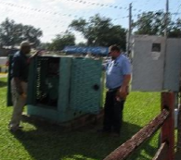


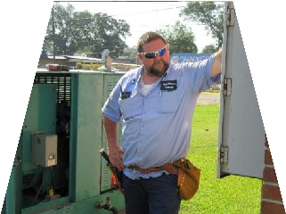
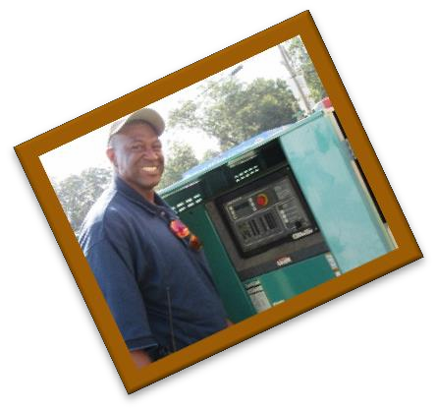



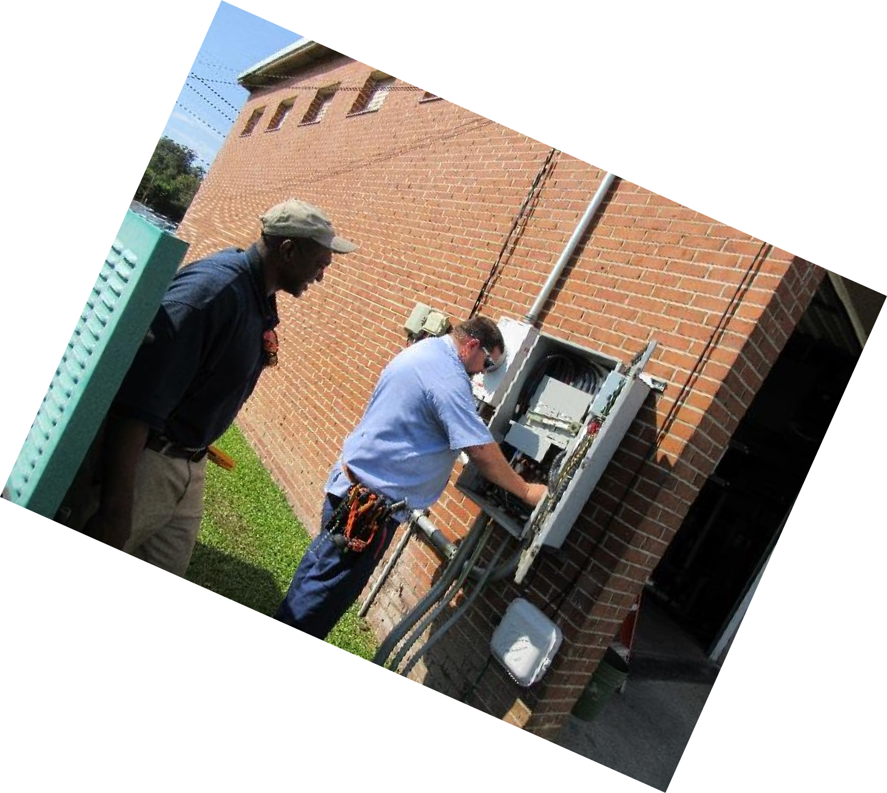
PUBLIC WORKS DIGEST: AN INSIGHT INTO THE DAILY WORKS |
Issue 1
4
Capital Projects
The Mission of Hattiesburg Public Works Capital Projects Division is to deliver a broad spectrum of quality public infrastructure projects safely, efficiently, and responsibly.
The Capital Projects Division is responsible for the assembling and implementation of the City's annual Capital Improvement Plan. Many capital improvement projects come under the public works umbrella including:
Management and fiscally responsible contract management efforts, the Public Works Division completes its mission daily.
Construction/remodeling of city buildings, bridges, traffic signals, bikeways, and street improvements.
Street improvements include:
Roadway pavement, curb, gutter, sidewalk, curb ramps, driveway approaches
Landscaped medians, storm drains, street lights, dry and wet utilities such as water pipelines, sewers, recycled waterlines
Electrical, telecommunication and cable conduits.
This division is dedicated to delivering projects which improve the quality of life of Hattiesburg residents so much so that the residents of Hattiesburg can have a strong sense of pride in their City. By utilizing an environmentally conscientious manner with full inter- governmental and public agency coordination, prudent real property acquisitions, diligent construction
SKIP MATTHEWS & WILLIAM JORDAN COMPLETE ELECTRICAL WORK AT FIRE STATION #5.

Slide 5
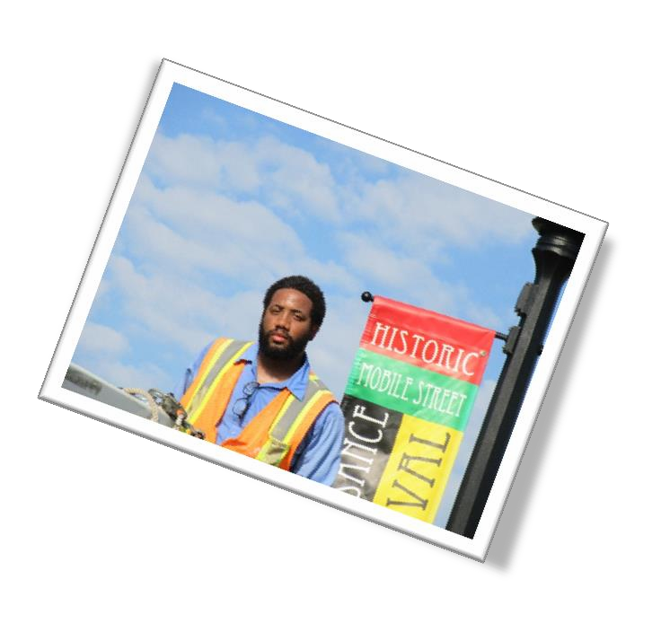


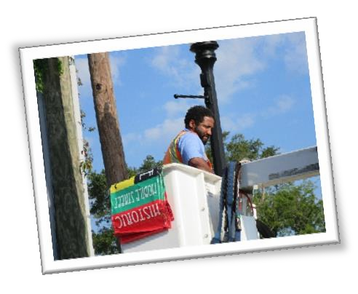


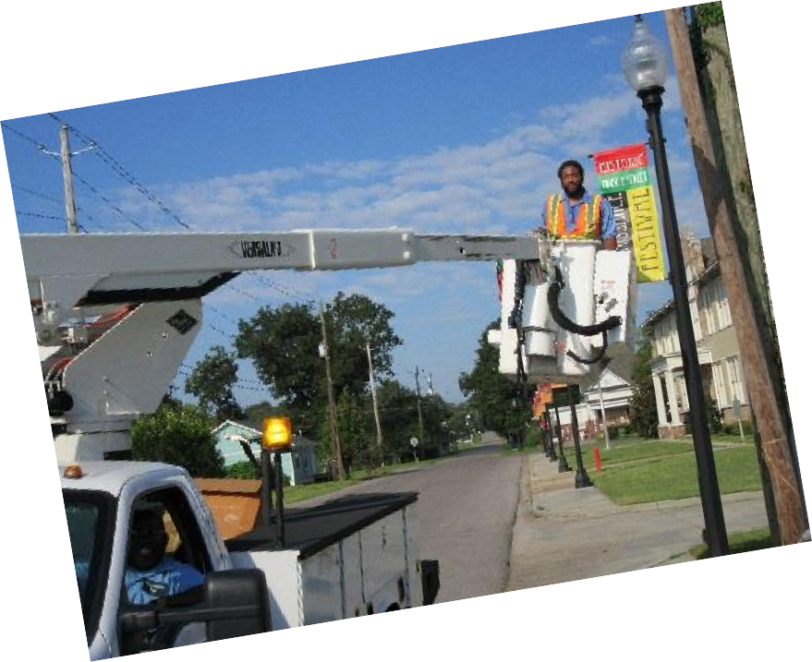


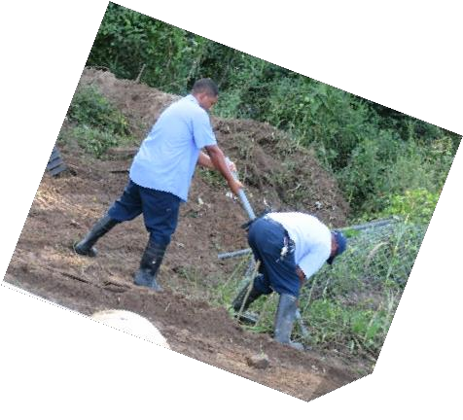
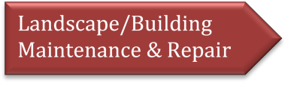
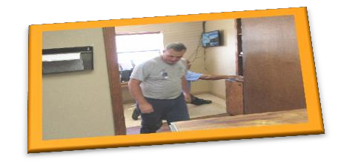


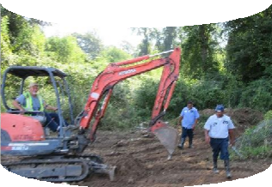


PUBLIC WORKS DIGEST: AN INSIGHT INTO THE DAILY WORKS |
Issue 1
5
Event Signage
The City of Hattiesburg’s Traffic Department is working harder than ever to make traveling simpler and easier for drivers. Part of the division is responsible for the special event signage throughout the city. Special event banner signs are temporary banners that are hung over the roadways and attached to light fixtures to advertise upcoming events in or near Hattiesburg.
JEROME PARKER & RANDY GATLIN PREPARE FOR THE UPCOMING 12TH ANNUAL HISTORIC MOBILE STREET FESTIVAL
Cost control is a driving issue behind using in-house maintenance. In- house labor is an increasingly prevalent method that the public works department uses to maintain
their assets and decrease cost throughout the department.
For More Information
Public Works - City of Hattiesburg {Control + Click} to follow link
DOUG, PATRICK & SHANNON PREPARE TO CLEAR THE FENCE LINE
BEHIND THE PUBLIC WORKS OFFICE.
Or Dial (601) 545-4545
Larry Barnes-Director
Theresa Evans—Administrative Asst. Cheryl Fluker –Traffic & Const.-Adm. Stephanie Moffett –Office Manager Chelsea Evans –Office Asst.
Regina Roberts –Telecommunication Jacquline McClain-Community Dev.
HARVEY & MR. JARVIS IMPROVE THE OFFICES BY INSTALLING FLOORING.

Slide 6

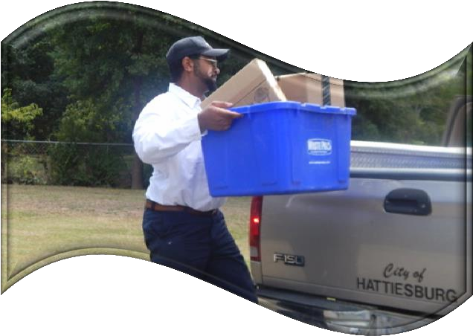
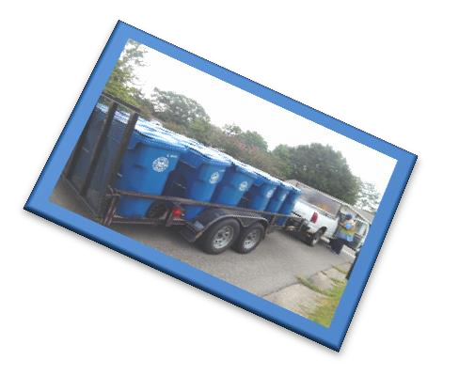
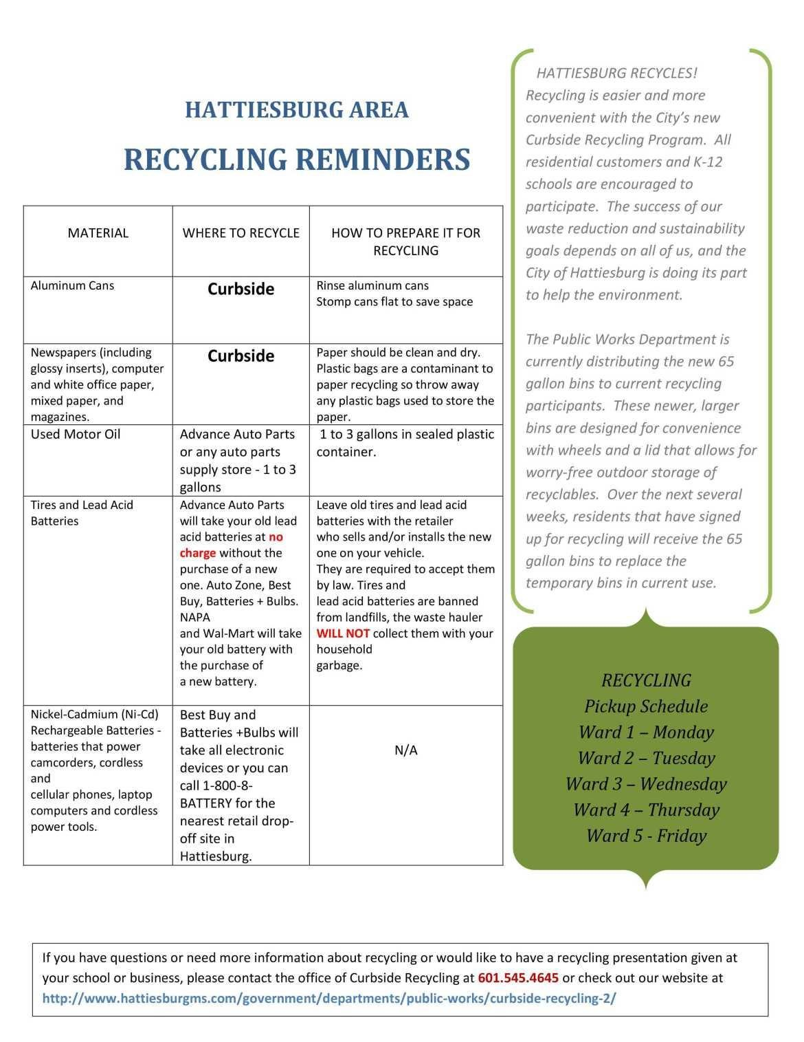
PUBLIC WORKS DIGEST: AN INSIGHT INTO THE DAILY WORKS |
Issue 1
6
Curbside Recycling
The Curbside Recycling program is an important part of the waste reduction and sustainability goals for the City of
Hattiesburg. Since the beginning of the program in January 2015, residents have recycled over 300 tons of material that would otherwise have gone into a landfill, and they are now be able to recycle more with the new, wheeled 65-gallon bins. The recycling program is growing every day, and all Hattiesburg residents are invited to sign-up.
Many of us feel overwhelmed by the term ‘recycling’. Recycling is nothing but process of using old or waste products into new products. It makes us feel proud of taking an important step towards reducing pollution and recycling is a fun activity especially when done in groups.
Recycling helps to reduce energy usage, reduce the consumption of fresh raw materials, reduce air pollution and water pollution (from land filling) by reducing the need for “conventional” waste disposal and also reduces greenhouse gases emissions.
So, before you toss it, ask yourself, can you recycle it?
For more information on recycling:
Nkrumah Frazier, Sustainability Officer
Jacquline McClain – Community Dev.
(601) 545-5406

